Slide 1

Training Publication SPI-06
Rev 1
24 Dec 2025
Understanding Process Failure Mode and Effects Analysis (PFMEA)
by Konrad Burgoyne MIMF, FSPI

Slide 2

Information
This training publication is provided for educational purposes and may be freely shared, copied and distributed. It is not subject to copyright restrictions.

Slide 3

Introduction
AIM: To establish a common understanding for effective process risk identification, assessment, mitigation and prevention.

Slide 4
Process Failure Mode and Effects Analysis
PFMEA is usually conducted as part of New Product Introduction (NPI)
PFMEA can equally be applied to products currently in production when the manufacturing processes are changed or being addressed for improvement
A failure mode is a cause of failure or a potential way a system can fail

Slide 5
Process Failure Mode and Effects Analysis
PFMEA is a risk identification and assessment for processes usually directly associated with manufacturing.
A process change is a change in material, method and/or measurement technique that can potentially affect form, fit or function

Slide 6
Process Failure Mode and Effects Analysis
So, what is it?
A PFMEA provides a structured, qualitative, analytical framework which taps the multi-disciplined experience of the team to brainstorm answers to such questions as:
How can this process, function, facility, or tooling fail?
What effect will failure have on the end product (or customer)?
How can potential failures be eliminated or controlled?

Slide 7
Process Failure Mode and Effects Analysis
PFMEA is accomplished using a cross-functional team that may include, manufacturing engineers, subject matter experts, process operators, quality engineers and process planners.
Effects analysis is a method of understanding and addressing the potential effects of failure

Slide 8
Process Failure Mode and Effects Analysis
Product Key Characteristics
Measurement Systems Analysis
Design Risk Analysis
Process Flow Diagram
Process Failure Mode and Effects Analysis
Control Plan
Work Instructions
Product and Processes Key Characteristics
Scope of this training
Information Relationships
AS13004 Scope

Slide 9
Process Failure Mode and Effects Analysis
Inputs to developing a PFMEA should include the following: -
Process Flow Diagram
Identification of all steps within each operation
Non-conformance data for similar products and processes, including lessons learned
Characteristics Matrix
Design Risk Analysis (e.g., DFMEA)
Existing PFMEA on similar products and processes
Product KCs (including customer defined KCs)
Process KCs (potential or as defined in the design records)
Control Plan from similar processes

Slide 10
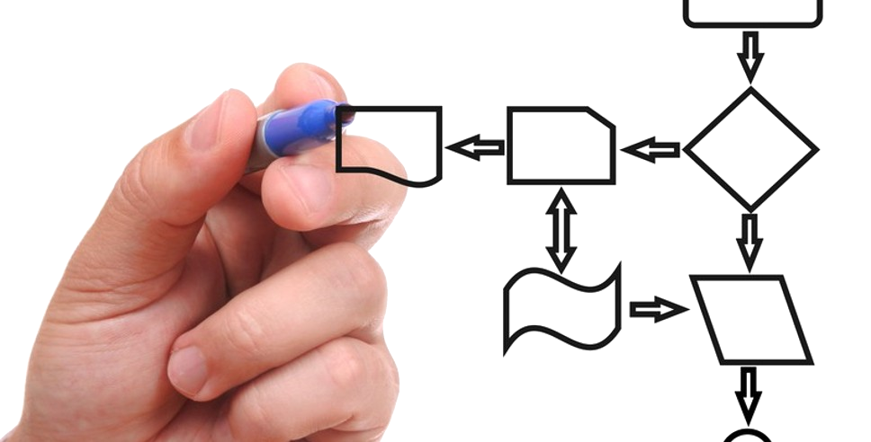
Process Flow Diagram (PFD)
A Process Flow Diagram (PFD) shows the relations between major components in a system

Slide 11
Process Flow Diagram (PFD)
Operation
Description
People
Inputs
Outputs
Documents
Process KC
Product KC
Controls
100 – CNC Drill set-up
Select correct NC program
Process Operator
Barcode on job card
Barcode on job card
Job card
NC program
Select correct tooling
Barcode on job card
Laser tool checker automated verify
200 – Tool set-up
Process Operator
Job card
Tooling
300 – Load material
Select correct material
Process Operator & Stores
Material. BoM kitting
Job card & BoM
Material specification
Material kitted by computer system
400 – Run CNC production
Operator sign off on job card
Completed operation
Machine to drawing
Process Operator
Machined part
Job card sign off
500 – Inspection verification
Inspect to drawing
Conforming part
Inspection sign off on job card
Conforms to drawing
Inspector
Drawing
Job card sign off

Slide 12
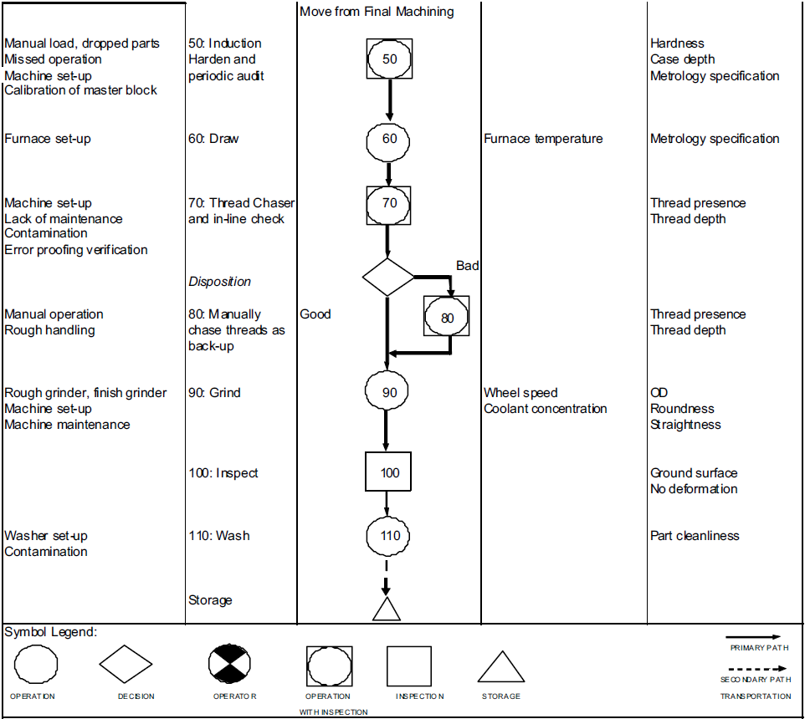
Process Flow Diagram Example – Flow Symbols

Slide 13
Process Failure Mode and Effects Analysis
Customer Requirements
Design Data & Drawing
Standards & Specifications
Purchase Order & Contract Review
Product Definition
Key Characteristics & Critical Items
Special Requirements
DFMEA
Process Definition
Process Flow Diagram (PFD)
Process Characteristics
Documented Assessment
PFMEA
Control Strategy
Control Plan
Error Proofing
Scope of this training
Information Flow
Manufacturing
Work Instructions
Process Control Documents
Job Card
AS13004 Scope

Slide 14
Process Failure Mode and Effects Analysis
Outputs from the development of a PFD should include:
Details of all operations in sequential order from receipt of materials through storage and shipment of finished product. This encompasses alternative processes, standard rework and movement of product from operation to operation as well as to and from external operations.
A Process Flow Diagram (PFD) shows the relations between major components in a system.

Slide 15
Process Failure Mode and Effects Analysis
6 Steps of PFMEA

Slide 16

STEP 1: Review the process
Use a process flow diagram to identify each process component.
List each process component in the FMEA table.
If it starts feeling like the scope is too big, it probably is. This is a good time to break the Process Failure Mode and Effects Analysis into more manageable chunks

Slide 17

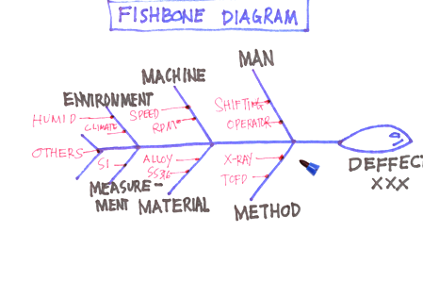
STEP 2: Brainstorm potential failure modes
Review existing documentation and data for clues about all of the ways each component can failure.
The list should be exhaustive – it can be paired down and items can be combined after this initial list is generated.
There will likely be several potential failures for each component

Slide 18

STEP 3: List potential effects of each failure
The effect is the impact the failure has on the end product or on subsequent steps in the process.
There will likely be more than one effect for each failure.

Slide 19
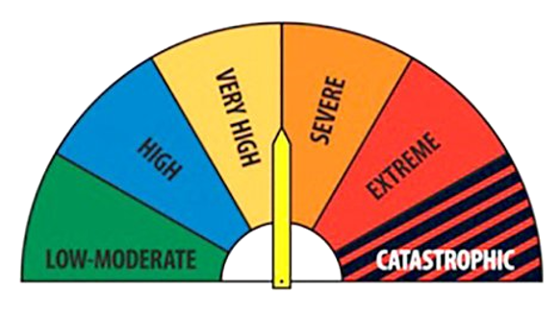
STEP 4: Calculate the Risk Priority Number(RPN)
Based on the severity of the consequences of failure.
Rate the severity of each effect using customized ranking scales as a guide. What are the chances the failure will be detected prior to it occurring.
Severity X Occurrence X Detection

Slide 20

STEP 5: Develop & Implement the action plan
Decide which failures will be worked on based on the Risk Priority Numbers. Focus on the highest RPNs.
Define who will do what by when. Implement the improvements identified by your Process Failure Mode and Effects Analysis team.

Slide 21

STEP 6: Calculate the resulting RPN
Re-evaluate each of the potential failures once improvements have been made and determine the impact of the improvements.

Slide 22
Example Documentation
Example Forms
Downloadable Microsoft Excel file can be found here:
https://sp-i.org/downloads.html

Slide 23
Example PFD 1 Form
Export Control Classification
Other restrictions
PROCESS FLOW DIAGRAM
PART NUMBER/S: |  |  |  |  |  |  |  |  |  |  |  |  | PREPARED BY:
PART / FAMILY DESCRIPTION: |  |  |  |  |  |  |  |  |  |  |  |  | DATE:
OPERATION | STEP | ADMINISTRATION | PACKAGING INTERACTION | LIFT (mechanical / other) | LOAD / INSTALL | FABRICATION / TRANSFORMATION STEP | MOVE | STORE | INSPECT | REWORK | OTHER (SPECIFY) | OPERATION DESCRIPTION | CLASSIFICATION | PRODUCT KC | PROCESS KC | CONTROL METHODS

Slide 24
Example PFD 2 Form
Export Control Classification
Other restrictions
PROCESS FLOW DIAGRAM
Process
Prototype - Pre-Launch - Production - |  |  |  |  |  |  | Date (Orig.)
Key Contact |  | Core Team |  |  |  |  | Date (Rev.)
 |  |  |  |  |  |  | Customer Approval Date
PROCESS DESCRIPTION | OPERATION | STEP | INPUTS | CLASSIFICATION | OUTPUTS | CONTROLS | MISTAKE PROOFING | REMARKS
 |  |  |  |  |  |  | Rev -

Slide 25
Example PFMEA Form
Export Control Classification
Other restrictions
Process Failure Mode and Effects Analysis (PFMEA)
Prototype - Pre-Launch- Production - |  |  |  |  | Key Contact / Phone |  |  |  |  |  | Date (Orig.) |  |  | Date (Rev.)
Part Number |  |  |  |  | Core Team |  |  |  |  |  | Customer Approval Date
Operation | Step | Process Function/ Description | Requirements | Potential Failure Mode | Potential Effect(s) of Failure | Severity | Classification | Potential Cause(s) of Failure | Current Process |  |  |  | RPN | Recommended Action | Responsibility & Target Completion Date | Action Results
 |  |  |  |  |  |  |  |  | Prevention Controls | Occurrence | Detection Controls | Detection |  |  |  | Actions Taken Completion Date | Severity | Occurrence | Detection | RPN
 |  |  |  |  |  |  |  |  |  |  |  |  |  |  |  | Rev -

Slide 26
Example Control Plan Form
Export Control Classification
Other restrictions
Control Plan
Prototype - Pre-Launch- Production - |  |  |  |  | Key Contact / Phone |  |  |  | Date (Orig.) |  | Date (Rev.)
Part Number |  |  |  |  | Core Team |  |  |  | Customer Approval Date
Part Name / Description
Operation | Step | Process Function / Description | Machine, Device, Jig, Tools For Mfg. | Characteristics |  |  | Classification | Methods |  |  |  |  | Reaction Plan
 |  |  |  | # | Product | Process |  | Requirements | Evaluation / Measurement Technique | Sample |  | Control Method
 |  |  |  |  |  |  |  |  |  | Size | Freq

Slide 27
Questions?

Slide 28
Revision Control
sp-i.org
email@sp-i.org
Rev | Date | Change | Author
1 | 24 Dec 2025 | Established training slide pack with the guidebook | Konrad Burgoyne

