Slide 1
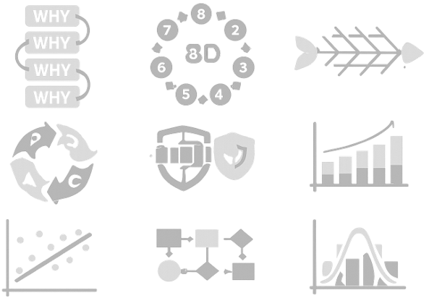
Training Publication SPI-05
Rev 2
24 Dec 2025
Understanding 8D RCCA Problem Solving
by Konrad Burgoyne MIMF, FSPI

Slide 2

Information
This training publication is provided for educational purposes and may be freely shared, copied and distributed. It is not subject to copyright restrictions.

Slide 3
Introduction
Aim
An introduction to the concept of root cause corrective action using the 5 Why and 8D method.
Reason
The objective of root cause analysis and problem solving is to reduce the number of issues and minimize their impact on quality, delivery performance, costs, and ultimately on the customer.
Incentive
RCCA is a fundamental and valued skill used within many areas of business.

Slide 4
Root Cause Corrective Action
Root cause corrective action is an effective process for finding the causes of an event and facilitating effective corrective actions to prevent recurrence.

Slide 5
Root Cause Corrective Action
A requirement of the aviation, space and defence industry for many years.
A process of determining the causes that led to a non-conformance or event.
Requirements are not new, but they may not have been aggressively enforced in the past.

Slide 6
AS9100 Requirement
10.2 Nonconformity and Corrective Action
10.2.1 When a nonconformity occurs, including any arising from complaints, the organization shall:
a. react to the nonconformity and, as applicable:
1. take action to control and correct it;
2. deal with the consequences;
b. evaluate the need for action to eliminate the cause(s) of the nonconformity, in order that it does not recur or occur elsewhere, by:
1. reviewing and analysing the nonconformity;
2. determining the causes of the nonconformity, including, as applicable, those related to human factors;
3. determining if similar nonconformities exist, or could potentially occur;
c. implement any action needed;
d. review the effectiveness of any corrective action taken;
e. update risks and opportunities determined during planning, if necessary;
f. make changes to the quality management system, if necessary;
g. flow down corrective action requirements to an external provider when it is determined that the external provider is responsible for the nonconformity;
h. take specific actions when timely and effective corrective actions are not achieved.
Corrective actions shall be appropriate to the effects of the nonconformities encountered.

Slide 7
Events
What is an Event?
An all-inclusive term for any of the following:
Product or Process Failure
Incident
Non-Conformance
Audit finding
Special Cause (SPC)
Accident
Customer complaint
Failure Mode (FMEA)
RCCA is not just for non-conformances

Slide 8
The Traditional Approach to an Event
Problem
Containment
Establish Team
Identify Problem
Gather & Analyze Data
Find the Root Cause
Determine Corrective Action
Implement Corrective Action
Review Corrective Action
Fix it

Slide 9
The Traditional Approach to an Event
START
Don’t touch it
Yes
Does it work?
No
Did you
Touch it?
No
Yes
Yes
Will you be blamed for it?
Does anyone
know you touched it?
This is bad news
No
No
Yes
Can you
transfer blame
to someone
else?
No
Yes
Uh Oh
Can it be fixed or hidden?
No
Hide it or throw away the evidence
Yes
PROBLEM
NO
PROBLEM

Slide 10
Examples of Traditional Behaviours
Quick fix.
Not taking adequate time for analysis.
Going from one crisis to another.
Looking for the guilty party - “Who did that?” Blaming or transferring responsibility.
Generate laundry list of solutions to firefight the symptoms.
Narrow focus taken to address the immediate problem.
Focus on performance metrics/measures (e.g., sales, profits) with hope that processes will improve by themselves.

Slide 11
Expected Behaviour To Get Systemic Solutions
Understanding that many factors contribute to a complex situation.
Fully understanding the actual problem and then addressing the systemic root cause(s).
Permanently fixing and improving performance.
Seeking total understanding of the process - “How did that happen?”
Taking time to understand the big picture; to dialogue and elicit diverse perspectives before applying the solution.
Focusing on improving processes; actually effecting process performance.

Slide 12
Risk Based Approach
Take Action:
To a degree appropriate to the magnitude of the problem.
Proportionate with the risks encountered

Slide 13
8D Process Approach
Eight Disciplines (8D) Problem Solving is a method developed at Ford Motor Company used to approach and to resolve problems, typically employed by engineers and quality professionals.
Focused on product and process improvement, its purpose is to identify, correct, and eliminate potential and recurring problems.

Slide 14
8D Process Approach
D0 – Start Immediate containment action
D1 – Build the team
D2 – Define the problem
D3 – Complete and optimise containment action
D4 – Identify root cause
D5 – Define and select permanent corrective actions
D6 – Implement corrective actions and check effectiveness
D7 – Risk and opportunity – Preventive action and lessons learned
D8 – Recognise and close the activity

Slide 15
D0 Immediate Containment Action
D0
Objective: To mitigate the impact of the problem, to protect the customer and the organisation (i.e., stop the problem from getting worse), and verify that the situation does not deteriorate until the root cause and contributing causes are known.
Stop – Prevent further production of nonconformities or worsening of the problem
Identify & Evaluate – Affected product, process, persons and equipment
Quarantine – Control identified product or equipment
Communicate – Inform affected stakeholders (including the customer if escapes are suspected)

Slide 16
D1 Build The Team
D1
Objective: To ensure that all process performers and applicable stakeholders and functions (e.g., organizations, departments, suppliers, customers) that may have an influence on the corrective action process and associated investigation are included in the team.
The Natural Team
Who owns the problem?
Who has a stake in the outcome and the solution to the problem?
Who are the vested owners of both the problem and the solution?
Who knows the process – have data and experience?
Who will have to implement and live with the corrective action?

Slide 17
D1 Build The Team
D1
Assignment of wrong personnel a common problem. Common to assign only Quality.
The Qualified Team
Those who can provide additional information
Those who have technical expertise – Subject Matter Experts (SME)
Those who may need to act as advisors
Those providing management support
Without the full buy-in and support of the stakeholders, long-term solutions are not likely

Slide 18
D2 Define the Problem
D2
Objective: To understand the significance, impact, and size of the problem (i.e., depth and breadth of current conditions) and ensure the situation (i.e., problem) is accurately defined and thoroughly understood by the team and applicable stakeholders.
You must understand the problem.
Is there more than one problem?
You must know what you don’t know, to be able to find out.
Keep it simple!

Slide 19
D2 Define the Problem
D2
Must be clearly and appropriately defined.
The nonconformities identified may not be the real problem – only a symptom of the problem.
Asking questions is helpful.
What is the scope of the problem?
How many problems are there?
What is affected by the problem?
What is the impact on the company?
How often does the problem occur?
Addressing appropriate questions will assist in clarifying and defining the problem(s).

Slide 20
D2 Define the Problem
D2
IMPORTANT
If you cannot say it simply, you do not understand the problem!

Slide 21
D3 Implement Containment Actions
D3
Objective: To ensure containment actions suitably address the problem statement and to verify that immediate corrective action is commensurate with the problem, implemented and effective.
Ensure that all nonconforming product or data has been isolated and corrected to prevent escape, and optimize immediate corrective action(s)
Additional containment actions may include:
temporary increase of production to support product needs;
over-inspection upstream in the process;
stock segregation at suppliers and sub-tiers, as applicable; and
product recall (still within the organization or already delivered).

Slide 22
D4 Root Cause Identification & Analysis
D4
Objective: To identify, through structured root cause analysis, the root cause for the undesirable condition, situation, nonconformity, or failure, including the reason it was not detected.
NOTE: Root cause analysis will identify the direct cause, contributing causes and the root cause for the problem.
Root Cause Analysis (RCA) is a systematic approach to determining all the contributors to a problem before attempting to implement a corrective action plan.

Slide 23
D4 Root Cause Identification & Analysis
D4
The Causal Chain
Direct → Contributing → Root
The direct cause is the cause that immediately caused the problem
Causes in-between are contributing causes
A root cause is the last cause in the cause chain
REMEBER - Root Cause:
It’s not always the most significant cause in the chain.
Just focus on the fact that it is the LAST cause in the chain

Slide 24
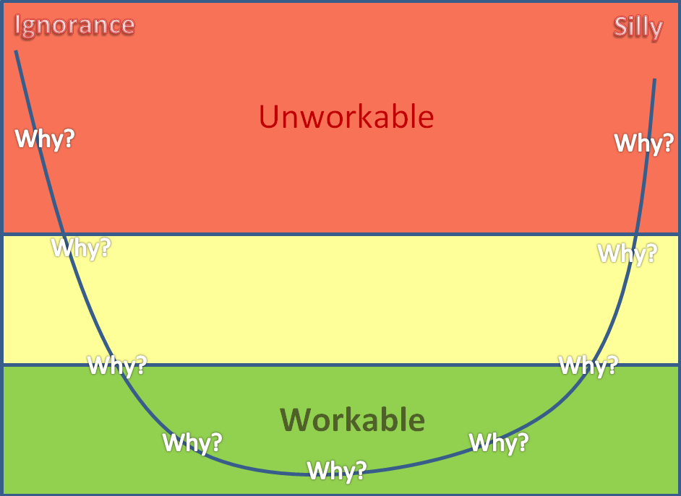
D4 Root Cause Identification & Analysis
D4
5 Why Process
The ‘5 why’ is one method that can be used to find the cause chain.
State the Problem as an event question starting with: Why…
An event question is short, concise and focused on ONE problem.
It is a question starting with Why . . . ?
It is the first “Why” in the process.
REMEBER - Do not believe that the 5 Why process restricts you to asking why 5 times
A root cause may be found with 3 Whys or it may take 7 Whys

Slide 25

D4 Root Cause Identification & Analysis
D4
5 Why Process
Don’t fall into the trap
Cause chain under construction.
No corrective actions allowed!

Slide 26
D4 Root Cause Identification & Analysis
D4
5 Why Process
Keep it simple!
Simple ‘Why’ question
Simple concise answer

Slide 27
D4 Root Cause Identification & Analysis
D4
Human Error can never be a root cause
Used as “root cause” too often - Used as an easy way out.
Human factors are a contributing cause but must be managed by robust processes
Ask: If the operator was replaced, could the next person make the same mistake? If so, then you have not determined the Root Cause.
Concentrate on systems and processes.

Slide 28
D5 Define and Select Corrective Actions
D5
Objective: To define, prioritize, and select corrective actions that should be implemented to address the causes (root causes and contributing causes) and permanently prevent the undesirable condition, situation, nonconformity, or failure from recurring.
Corrective Action
A set of planned activities (actions) implemented for the sole purpose of permanently resolving the problem.
Types of Corrective Action
Specific corrective action addresses only the direct cause or the effect. Action(s) taken to correct the direct cause and/or the effect.
Sustaining corrective action addresses contributing and root causes. Actions taken to prevent recurrence of the event

Slide 29
D5 Define and Select Corrective Actions
D5
What, Who, When.
What is the corrective action?
Who is responsible for doing it?
When is it going to be done?

Slide 30
D5 Define and Select Corrective Actions
D5
Establish the most effective corrective action to put in place.
Must address the root cause
Must address contributing causes
Must be workable
Must have a effectivity date
Must be sustainable
Must not be the cause of other unforeseen non-conformances
Must be reviewed

Slide 31
D6 Implement Corrective Actions
D6
Objective: To ensure all selected corrective actions are implemented (as defined), and to assess their effectiveness in preventing the undesirable condition from recurring and/or in detecting it sufficiently upstream in the process.
Too often, at this step of the corrective action process, focus is only on the implementation of the easiest and quickest solutions, and there is no plan to verify timely implementation of the actions and their overall effectiveness; resulting in the corrective action plan being only partially implemented.
At this stage, the key role for the team leader is to ensure that the entire corrective action plan (proposed solutions) has been implemented in a timely manner and was effective.

Slide 32
D6 Implement Corrective Actions
D6
Establish a review process to ensure corrective actions are completed per the plan and will continue to be effective over time:
Process confirmation, confirming that all planned actions have been completed.
Definition of type and number/frequency of additional checks and audits.
Identify measures required to verify effectiveness of actions (e.g., who, what, where, frequency, conditions). Measure and analyse new process performance (as planned) and compare results with performance measured at Steps 2 and 4.

Slide 33
D6 Implement Corrective Actions
D6
Verify effectiveness of the proposed solutions:
If the RCCA is not effective, return to D4 (Identify Root Cause) and revisit the root cause analysis process to check if the failure was with the identification of the root cause(s) and/or in the development/implementation of the corrective action.
If they are effective, evaluate which containment actions may be eliminated (e.g., stop over inspection and over production, return to normal transportation means) without adversely affecting the product and process output / performance.
Record evidence of actions completed and associated results (i.e., what works and what does not).

Slide 34
D7 Risk and Opportunities
D7
Objective: To document analysis, results, and changes to capture and share learning with applicable stakeholders to prevent similar undesirable condition, situation, nonconformity, or failure occurring on other products, production lines, factories, or suppliers.
This stage has been known as ‘Preventive Action’, ‘Lessons Learnt’ and is now referred to as ‘Risks and Opportunities’
Identify all other data, products, production lines, factories, or suppliers that may potentially be affected by the same or similar undesirable condition, situation, nonconformity, or failure (e.g., similar design, process, material source/supplier, location, function/use, environment, training, machines/tools). Identify applicable information that can be shared from this incident and transfer across those identified business units, production lines, factories, or suppliers.

Slide 35
D8 Recognise the Team and Close
D8
Objective: To ensure all team members and stakeholders are aware of the successful implementation of all corrective action, to confirm that the activity is closed, and to recognize and reward their work and accomplishment
Confirm that all actions have been successfully implemented; record synthesis of causes, actions, and methodology; inform applicable stakeholders affected by the undesirable condition, situation, nonconformity, or failure that the activity is complete; recognize those who have been involved in the corrective action process; and disband the team.
Why? Too often action items are left open, diverting people from their primary roles. Furthermore, closed-loop corrective action is not achieved because there is no feedback of actions/results to applicable stakeholders and team efforts are not recognized, which negatively affects the dynamics of the RCCA culture.

Slide 36
When to Apply RCCA
The process should always be applied, if one or more of these conditions exist:
Safety impact (product/personal).
Product strength, performance, and/or reliability issue.
High impact on production/maintenance operations.
Stop the production/maintenance line; prevent next operation to occur satisfactorily, etc.
Regulatory authorities and/or customer dissatisfaction.
Costs issue (generated to the customer or the organization).
Disruption of supplier’s process or customer’s operations.
Repetitive problems to one part or similar activities/processes.
Difficulty to detect.
Customer request.
Significant quality or QMS issue.
Complex problem that cannot be solved without assistance of other people than those located where the problem occurred.
The impact of an issue and the frequency of its occurrence should always be considered when deciding to launch or not launch a formal root cause analysis

Slide 37

8D Example
The next set of slides demonstrate a real-world example of an 8D in action

Slide 38
The DOT Assembly Incident
During night shift while working on DOT assembly an incident occurred when attempting to fit the 686 TE hose to the fuel inlet fitting 547765, the attachment 7678 CL was unable to be tightened enough to secure the 686 TE hose.
When the job card BOM was checked, attachment 7673 CL was referenced but attachment 7678 CL was kitted for the assembly. 7678 CL is larger than 7673 CL and not able to be tightened to the diameter of the 686 TE hose.
Dave from stores said that 7678 CL are left over from the DPE assembly and should fit the same as 7673 CL.
Pete who kitted all the parts and checked his BOM list and found that line item 7673 CL had an oil smudge on the page that made the 3 of 7673 CL look like an 8. Job card 23244 affected, NCR 101 Raised.

Slide 39
D0 Immediate Containment Action
D0
Objective: To mitigate the impact of the problem, to protect the customer and the organisation (i.e., stop the problem from getting worse), and verify that the situation does not deteriorate until the root cause and contributing causes are known.
Stop – Prevent further production of nonconformities or worsening of the problem
Identify & Evaluate – Affected product, process, persons and equipment
Quarantine – Control identified product or equipment
Communicate – Inform affected stakeholders (including the customer if escapes are suspected)

Slide 40
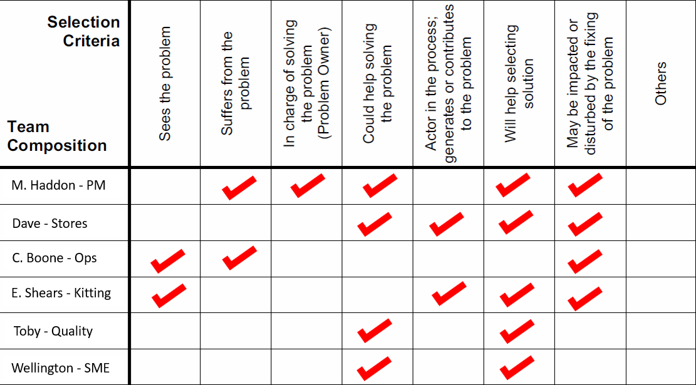
D1 Build The Team
D1
Team composition template (example)

Slide 41
D2 Define the Problem
D2
Complicated Problem Example
During night shift while working on DOT assembly an incident occurred when attempting to fit the 686 TE hose to the fuel inlet fitting 547765, the attachment 7678 CL was unable to be tightened enough to secure the 686 TE hose. When the job card BOM was checked, attachment 7673 CL was referenced but attachment 7678 CL was kitted for the assembly. 7678 CL is larger than 7673 CL and not able to be tightened to the diameter of the 686 TE hose. Dave from stores said that 7678 CL are left over from the DPE assembly and should fit the same as 7673 CL. Pete who kitted all the parts and checked his BOM list and found that line item 7673 CL had an oil smudge on the page that made the 3 of 7673 CL look like an 8. Job card 23244 affected, 8D Form 101 Raised.

Slide 42
D2 Define the Problem
D2
Simple Problem Example
Incorrect part fitted – 7678 CL instead of 7673 CL on DOT assembly on job card 23244

Slide 43
D3 Complete and Review Containment Actions
D3
Example Containment Review
Product evaluation determined that only job card 23244 DOT serial 23244-01 is affected by the problem
No product recall required
No customer notification required
No stock segregation required
All BOM and kitting reviewed and found conforming
Continue production of all other DOT assemblies
Record activities on 8D Form 101

Slide 44
D4 Root Cause Identification & Analysis
D4
5 Why Example
1. Why was attachment 7678 CL fitted to DOT on job card 23244?
It was kitted for the assembly
2. Why was 7678 CL kitted for 23244 DOT assembly?
7673 was misread as 7678 on the BOM because of oil smudge
3. Why was oil on the BOM?
Protective plastic sleeve for BOM was damaged because of too many reuses
4. Why is the plastic protection reused when damaged?
No checks for condition of plastic protection in place before reuse
5. Why are no checks performed to confirm condition of plastic protection?
No established process or owner to confirm usability of protective sleeve
Root cause: No established process or owner to confirm usability of protective sleeve

Slide 45
D5 Define and Select Corrective Actions
D5
Example Corrective Action
A process was established and agreed by all stakeholders: -
Before paperwork is placed into plastic sleeves they are checked for serviceability.
Damaged sleeves are to be discarded.
Awareness Training to include
Everyone is responsible for replacing protective sleeves when found.
Everyone is responsible for ISO 9001:2015 7.5.3.2 b. Preservation of documented information legibility.
Increased awareness of FOD to include stains, smudges and other marks that affect documentation legibility
To be implemented and reviewed NLT 22 November

Slide 46
D6 Implement Corrective Actions
D6
Example Corrective Action Implementation
An audit / review was conducted on all current BOMs in use for adequate protection. 34 out of 100 found to be potentially unserviceable. All 34 were replaced with new protection.
The established process was implemented
Awareness Training was delivered
A review of the corrective actions was conducted by a follow up audit of BOMs in use and found no unserviceable protective sleeves in circulation.

Slide 47
D7 Risk and Opportunities – Preventive Action
D7
Risk and Opportunity Example
A review of all the shop floor paperwork was conducted and the established process extended to include all documented information that was issued for use in environments that could affect legibility of documents.
Regular checks are made on plastic protective sleeves for damage. The stock and purchasing process was reviewed to ensure an adequate supply of plastic sleeves are available at all times.

Slide 48
D8 Recognise the Team and Close the Activity
D8
Closing the 8D and Team Recognition Example
Further work was completed to source more cost effective and environmentally welcoming solutions. This has resulted through the hard work of all stakeholders involved in a 15% decrease in protective sleeve costs and the new supply is 100% biodegradable.
8D 101 is now closed as all actions completed.

Slide 49
Questions?

Slide 50
Revision Control
sp-i.org
email@sp-i.org
Rev | Date | Change | Author
1 | 10 Sep 2016 | Established training slide pack with the 8D RCCA guidebook | Konrad Burgoyne
2 | 24 Dec 2025 | Rebranding update to document | Konrad Burgoyne

